Slide 1
Quality Assessment and Communicating Student Learning
Updated October 2022
Part 2
Notes:
Welcome to part 2 of the Quality Assessment and communicating student learning series.

Slide 2
Included in Part 2
The ‘Big’ Picture
The Essential Elements of Quality Assessment and Communicating Student Learning (CSL)
Notes:
Included in part 2:
The ‘Big’ Picture
The Essential Elements of Quality Assessment and Communicating Student Learning (CSL)

Slide 3
Assessment is Personal
It is about who our students are, how they see themselves, and who they want to become
It is about relationships and a sense of belonging, first and foremost
It supports and drives personalized learning
It is therefore a partnership between students and teachers
It should be optimistic, and hold the promise of success
It should build confidence, develop efficacy, and inspire hope
Notes:
As mentioned in part one, our learners are always at the center of the curriculum design, learning, and assessment process. And one of the questions we as educators always try to consider is how can assessment support human development and the whole learner? Assessment is incredibly personal and it impacts our students' identities and how they see themselves and influences who they think they can become.
Too often, assessment, reporting and the way we talk about learning weaves a negative narrative about learning, abilities, and self for our students. So how can we shift the way we design and speak about learning and assessment, so that it supports human development, and inspires hope for our learners? It needs to begin with strong relationships and a sense of belonging first and foremost. If we want our students to take risks in their learning, and articulate what their needs are, then they need to have a relationship of trust with their teachers, and sense of belonging in their classroom and schools. When we talk about belonging, we’re not talking about ‘fitting in’ which can be incredibly oppressive, but rather belonging in the sense that they are accepted and appreciated for who they are and where they are in their personal development and learning
To support this, our redesigned curriculum and assessment processes drive personalized learning because we identify each students' strengths and next steps for development and growth. Ideally, we want our students to be able to recognize their own strengths and next steps. It is therefore a partnership and a relationship between students and teachers. It should be optimistic and hold the promise of success – this doesn’t mean we only talk about the good stuff, we of course determine next steps but first find what the student is able to do and show what pieces of the criteria they are able to demonstrate. We don’t talk in deficit and therefore it builds confidence, develops efficacy and inspires hope in our learners.

Slide 4
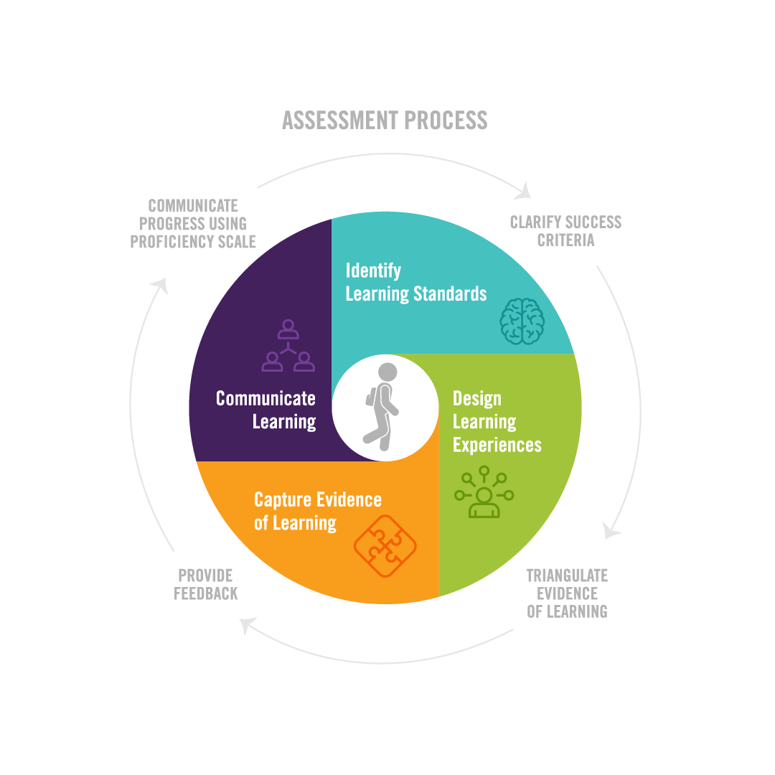
/CREATE PROFICIENCY SCALES
& REPORTING
Essential Elements of Quality Assessment and CSL
Notes:
Quality assessment and CSL is a process that honours learning as a continuous journey that focuses on growth and improvement over time and provides a window into student learning. It is a process that ensures that assessment is fair, transparent, equitable and responsive to all learners. Teachers design their curriculum and engage in assessment in ways that are unique to who they are and align with their practice. What we have tried to capture in this infographic is the learning process and the alignment between curriculum design and assessment. Teachers may enter this process at various points but what we have done here is included the following essential elements that make quality assessment fair, transparent and equitable. Throughout these modules we will be unpacking this process in more detail

Slide 5
Learning standards are derived from the curriculum
They are the points of reference for determining student growth and achievement and for clearly communicating student learning
Criteria are identified to help guide students in achieving success in the learning standards.
teachers go through the process of clarifying success criteria and proficiency scale or progression for that standard
& REPORTING
/CREATE PROFICIENCY SCALES
Notes:
I am going to begin with the learning standards of our curriculum.
Learning Standards: what all students are expected to know, be able to do, and understand (KDU Curriculum Model).
Once we have determined which learning standards we will be developing, teachers go through the process of clarifying success criteria and proficiency scale or progression for that standard.
These are now the points of reference for determining our teaching, assessment practices and communication of student learning. We make assessment transparent when students are aware of the progression of learning. They are able to articulate where they are in their learning, and what they are focusing on next for further development. This process makes students more assessment capable.

Slide 6
& REPORTING
Teachers design a variety of opportunities for all students to develop the knowledge, skills and processes embedded within the learning standards
Students demonstrate their learning in relation to the success criteria
Learning is captured through products/artifacts, stories/narratives, and observations (Triangulating evidence of learning)
/CREATE PROFICIENCY SCALES
Notes:
With these in mind we design our learning experiences including what skills we will be explicitly teaching and a variety of opportunities for all students to explore and develop the learning standards and demonstrate the success criteria
When our learning progressions and scale for the standard are clear it opens up the doors for students to demonstrate their learning in a variety of ways.
learning is captured through products/artifacts, stories/narratives, and observations (Triangulating evidence of learning). This collection of student work is gathered over time to provide a full profile of the learner and the learning.
When considering a student centered approach to assessment, it is important to honour the ways that our students feel they can articulate their learning best as long as it includes all of the success criteria.
We will go into more detail about triangulation of learning later in this series.

Slide 7
Students can demonstrate learning in a variety of ways
Students self-assess using the success criteria and identify their strengths, next steps and goals for improvement
Students become more assessment capable and are able to articulate their learning and growth
& REPORTING
/CREATE PROFICIENCY SCALES
Notes:
By empowering students to demonstrate their learning and curate their story we allow them to share ownership of the learning. This allows students to be more assessment capable. They are aware of the criteria, they make choices about how they will demonstrate their learning and are thereby able to self-assess more accurately.
Feedback whether peer or teacher, is connected to the success criteria, is in strength-based language, and identifies the strengths and next steps; it also guides teacher instruction. This allows teachers to clearly communicate to the learner and parents and caregivers where the student is at in relation to the learning standards, what they are working towards, and ways that learning can be supported. Parents and caregivers are encouraged to engage in conversations about learning with their child and provide their feedback where they feel comfortable.

Slide 8
Teachers and learners to clearly communicate to parents/caregivers where the students are in relation to the learning standards providing proficiency indicators/letter grades/percentages
Descriptive feedback describes the student’s strengths and next steps and ways that learning can be supported
This process also guides and informs teacher instruction and next steps
Parents/caregivers are encouraged to also provide feedback and comments where they feel comfortable
& REPORTING
/CREATE PROFICIENCY SCALES
Notes:
Once teachers feel they have assessed sufficient evidence of a learning standard they indicate what level of proficiency the student has demonstrated with parents and caregivers.
This process continues to provide students ample opportunities to practice and develop proficiency of the learning standard throughout the year.
These essential elements lead to transparency in the assessment process and provide students with opportunities to take ownership (voice) of their learning which leads to increased motivation and achievement

Slide 9
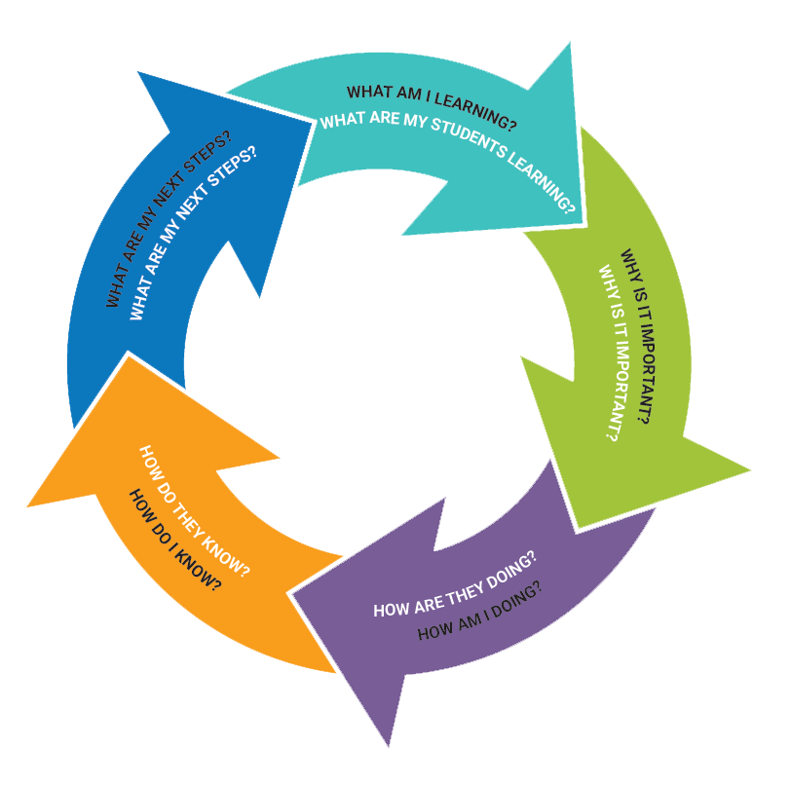
& REPORTING
/CREATE PROFICIENCY SCALES
Notes:
The hope is that when learning and assessment process is fair, transparent and equitable, students are able to respond to these questions.
And at the same time the teacher can be engaging in the same process.
What am I learning, What are my students learning?
Why is it important?
How am I doing, how are my students doing?
How do I know? How do they know?
What are there next steps/what are my next steps?...

Slide 10
PAUSE
Q1: How are you making the learning and assessment process transparent and equitable to your students?
Q2: How are/can you involve your students in the learning and assessment process, so that personalizing the learning is a shared experience?
Notes:
This is the end of part 2. Please Pause the video at this time and engage in table talk discussions with the following question.

